Slide 1



NAVIGATE
COLLEGE TUTORIAL RESOURCE
2025/2026

Slide 2

MARCH RESOURCE
Note - This is a ready-made Navigate resource pack intended for use within college tutorials or sessions. You are welcome to use it as provided or adapt it to better suit the specific needs of your college and students.
These resources are designed to support student engagement with key national events and topics throughout the academic year.
Please ensure that all activities are recorded on Navigate against each participating student.

Slide 3
HOW TO USE THIS RESOURCE
Step 1: Choose Your Icebreaker
Step 2: Review the Tutor Notes
Step 3: Follow the Session Plan
Step 4: Deliver Using the Slides and Resources
At the end of this pack, you’ll find three icebreaker options designed to introduce the session’s theme. Review these and select one that best suits your group’s energy, time, and context.
Before delivering the session, read through the tutor notes to understand the background and purpose of the topic. These notes will help you feel confident in leading the discussion and provide key points to include in your delivery.
Use the 30–35 minute session plan as your guide. It offers a suggested flow with timing and activity breakdowns to help structure your delivery effectively.
Work through the main input slides, activity slides, and reflection slides in order. Use any additional printable resources provided to support the main activity.
This pack is available in both PowerPoint and Canva formats so you can adapt and edit the materials to suit your college’s needs.

Slide 4
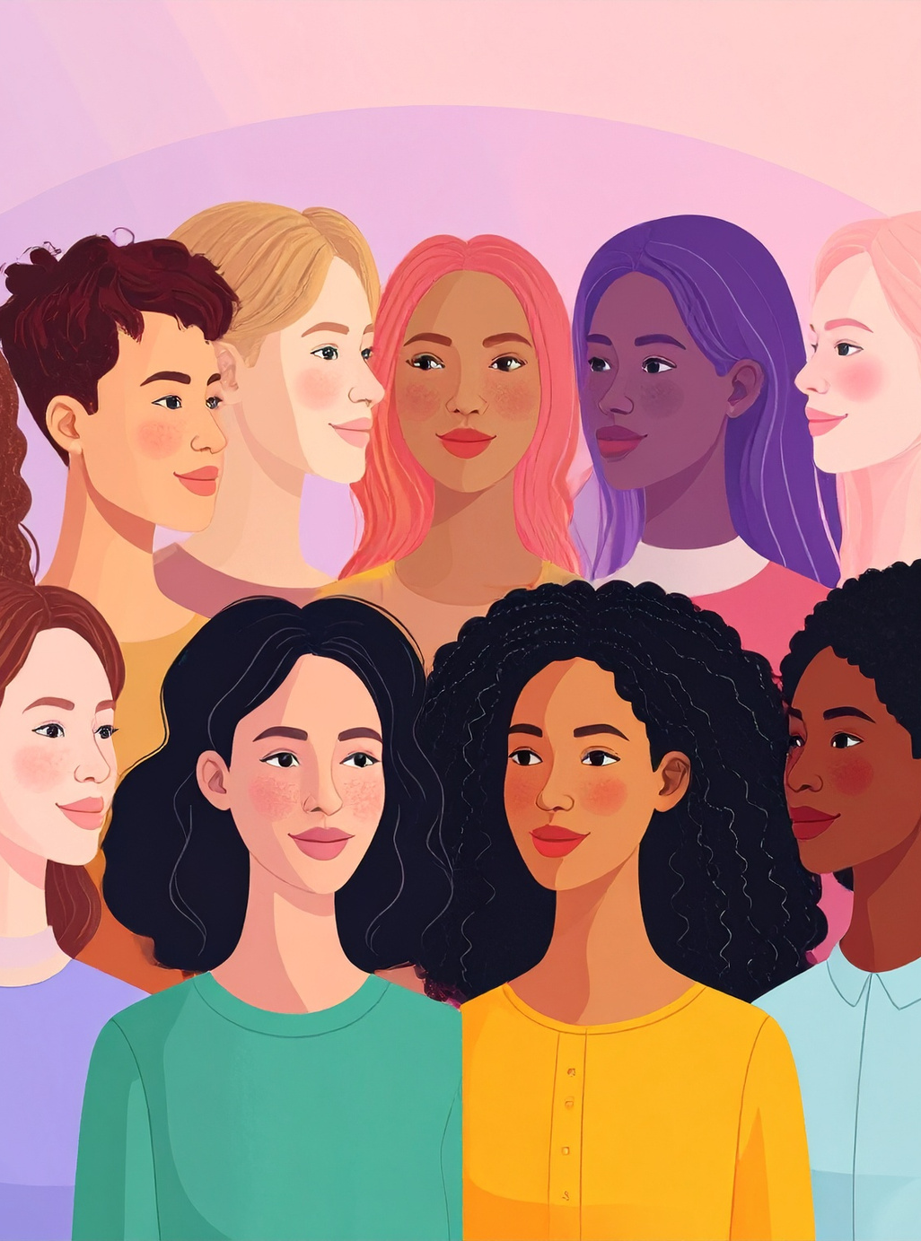
Tutor Notes: Topic Context
01
Tutor Notes: Session Plan
02
Main Activity Instructions
03
Introduction
04
Session Slides
06
Icebreaker Option 1
15
Icebreaker Option 2
24
Icebreaker Option 3
32
TABLE OF CONTENTS

Slide 5

TUTOR NOTES
INTERNATIONAL WOMEN’S DAY
International Women's Day (IWD), celebrated annually on March 8, is a global day celebrating the social, economic, cultural, and political achievements of women. The day also marks a call to action for advancing gender equality.
IWD has been around for well over a century, with the first IWD marked in 1911.
In 2026, IWD marks an extraordinary milestone: 115 years of collective action, advocacy, and progress toward gender equality. For more than a century, IWD has helped drive transformative change. Each generation has built on the courage of those before it, pushing boundaries and redefining what is possible.
Link - International Womens Day Resources
What are the aims of IWD?
IWD can mean different things to various groups, yet the overarching aims of IWD are to:
  1. Celebrate women’s achievements through recognizing and appreciating the contributions of women in various fields, highlighting their influence and successes throughout history and in the present day.
  2. Raise awareness of gender inequality through shining a light on persistent issues like the gender pay gap, lack of representation in leadership roles, gender-based violence, and unequal access to education and opportunities.
  3. Mobilise action for equality through encouraging individuals, communities, and organizations to take steps toward creating a more inclusive and equitable world for women.
  4. Donate and fundraise for women-focused charities, and elevate the visibility of their work.
  5. Foster solidarity among people of all genders in support of women’s rights and gender parity worldwide.
| 01

Slide 6
TUTOR NOTES
PLAN
1. Starter - Icebreaker(5–7 mins) Choose one icebreaker
  Icebreaker 1: Guess The Achievement - Students guess which woman accomplished what achievement.
  Icebreaker 2: International Women’s Day Quiz - Complete the quiz & learn more about IWD.
  Icebreaker 3: Emoji Film Decode - Guess the film that features strong female leads or stories by the emoji’s
2. Main Tutor Input: (10 mins)
  Purpose: Give students a clear understanding of the current theme for IWD
  Introduce what International Women’s Day is and why it is matters/celebrated.
  Go over celebrating achievements and barriers that women can face.
  Your input clearly prepares students to think about: Achievement, Barriers, Resilience, Everyday impact
3. Main Class Activity (15 mins)
  Divide into groups (4–6) or pairs.
  Students to discuss a woman (in their life or not) who inspires them by answering the questions
  Students can share and feedback to class individually/as a group/in pairs
  Tutor link back to: Respect/ Opportunity/ Representation/ Challenging stereotypes
4. Reflection & Wrap (5–8 mins)
  Ask: the questions on the reflection page as well as “One new thing you learned today?”
  Encourage volunteers to share.
  Show Navigate slide → prompt students to log learning/reflections.
| 02

Slide 7
TUTOR NOTES
MAIN GROUP ACTIVITY
INSTRUCTIONS
THE WOMAN WHO INSPIRES ME
Students to discuss in groups a woman in their life, community, or society who has influenced or inspired them.
This could be:
  A family member
  A teacher
  A public figure
  A coach
  A friend
  A historical figure
  Who is she?
  What has she achieved or overcome?
  What barriers might she have faced?
  How does her story link to the aims of International Women’s Day?
  What quality do you admire most?
They can:
  Write a short paragraph
  Present this back individually/ pairs/groups
  Or record a short reflection directly on Navigate
| 03

Slide 8
TUTOR NOTES
INTRODUCTION
WHAT IS INTERNATIONAL WOMEN’S DAY?
International Women’s Day (8th March) is a global day that:
  Celebrates women’s achievements across history and today.
  Raises awareness of gender inequality that still exists worldwide.
  Encourages action to create a more equal and inclusive society.
| 04

Slide 9
TUTOR NOTES
INTRODUCTION
WHY IS IT CELEBRATED?
The day is celebrated to:
  Recognise and celebrate the social, economic, cultural, and political achievements of women.
  Raise awareness of gender inequality and the work still needed to achieve equality.
  Promote respect, inclusion, and equal opportunities for all.
  Encourage action to challenge stereotypes and discrimination.
| 05

Slide 10

INTERNATIONAL WOMEN’S DAY
#GIVE TO GAIN

Slide 11

LEARNING OBJECTIVES:
By the end of this session, you will…
  Understand what International Women’s Day is and why it is celebrated.
  Recognise the achievements and contributions of women globally and locally.
  Explore ongoing challenges relating to equality.
  Reflect on how you can promote respect, fairness, and inclusion.
| 07

Slide 12


ICEBREAKER
PICK AN ICEBREAKER TO START THE SESSION THEN MOVE ON TO THE MAIN ACTIVITY
MAIN ACTIVITY
TODAY WE’LL BE LEARNING ABOUT INTERNATIONAL WOMEN’S DAY.
| 08

Slide 13

MAIN ACTIVITY
WHAT IS INTERNATIONAL WOMEN’S DAY?
International Women’s Day (IWD) is celebrated every year on 8th March and has been recognised globally since 1911. It began as part of a movement demanding better working conditions, fair pay, and voting rights for women.
Over time, it has grown into a worldwide day of recognition and action.
International Women’s Day is not just about history but also understanding where progress has been made and where change is still needed.
| 09

Slide 14
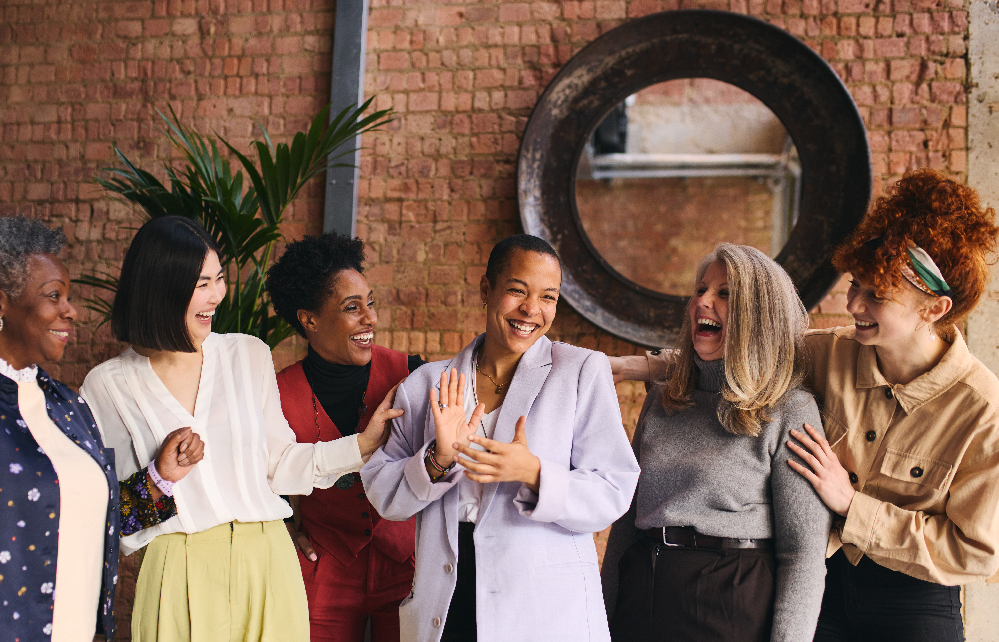
MAIN ACTIVITY
International Women’s Day is not only about world leaders or celebrities. It is about recognising the achievements of women in all areas of life, including those in our own families, communities, and workplaces.
Achievement does not always mean fame. It can mean:
  Being the first in a family to attend university
  Balancing work and family responsibilities
  Challenging stereotypes in a chosen career
  Supporting others through adversity
This day encourages us to recognise those contributions.
CELEBRATING ACHIEVEMENT: BIG OR SMALL
| 10

Slide 15
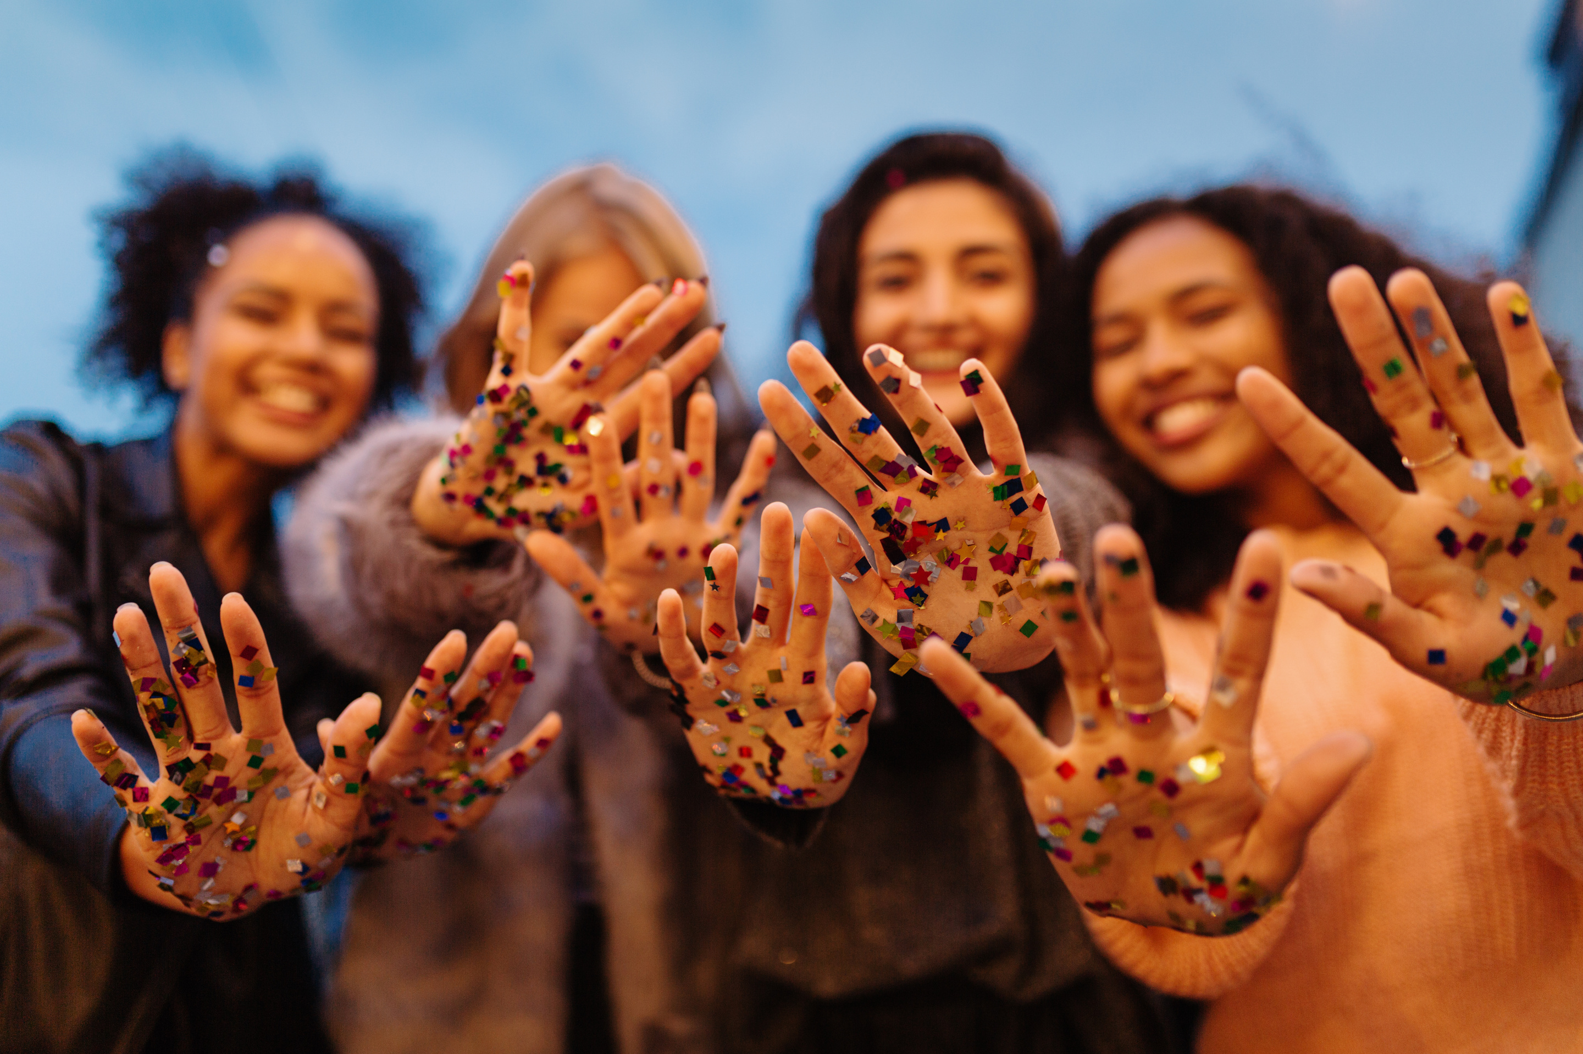
MAIN ACTIVITY
BARRIERS & STRENGTH
Although progress has been made, many women still face barriers such as:
  Gender stereotypes affecting expectations and opportunities
  Unequal representation in leadership roles
  Online harassment or discrimination
  Pressure around appearance or behaviour
Understanding these barriers helps us appreciate the resilience and strength shown by many women in everyday life.
International Women’s Day encourages us not only to recognise this, but to think about how we can support fairness and respect moving forward.
| 11

Slide 16

MAIN ACTIVITY
MAIN ACTIVITY
Discuss in groups a woman in your life, community, or society who has influenced or inspired you.
This could be:
  A family member
  A teacher
  A public figure
  A coach
  A friend
  A historical figure
  Who is she?
  What has she achieved or overcome?
  What challenges/barriers might she have faced?
  How does her story link to the aims of International Women’s Day?
  What quality do you admire most?
| 12

Slide 17

MAIN ACTIVITY
REFLECTION
  Why is International Women’s Day still important today?
  What did today’s session make you realise about equality?
  How can recognising women’s achievements change attitudes?
  What stereotype can you challenge in everyday life?
| 13

Slide 18

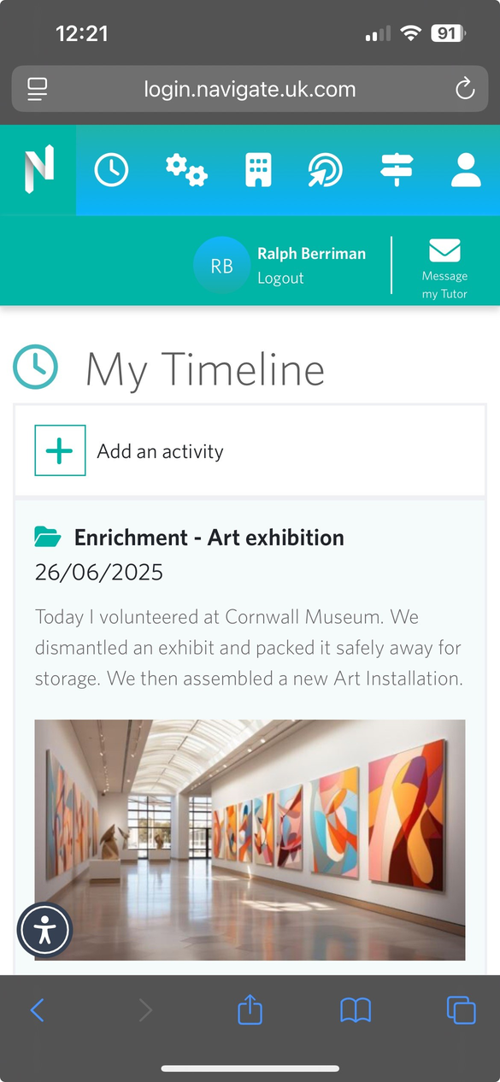
ADD TODAY’S ACTIVITY ON
Some questions to ask yourself when reflecting:
  What did you do or learn today?
  What questions did you ask today?
  What skills have you developed?
  What did you find interesting or challenging?
  What can you improve on?
  How can this experience/activity help you in the future?
Start building your Digital CV

Slide 19
ICEBREAKER OPTION 1
GUESS THE ACHIEVEMENT
Read the achievement and guess which woman accomplished it.
| 15

Slide 20
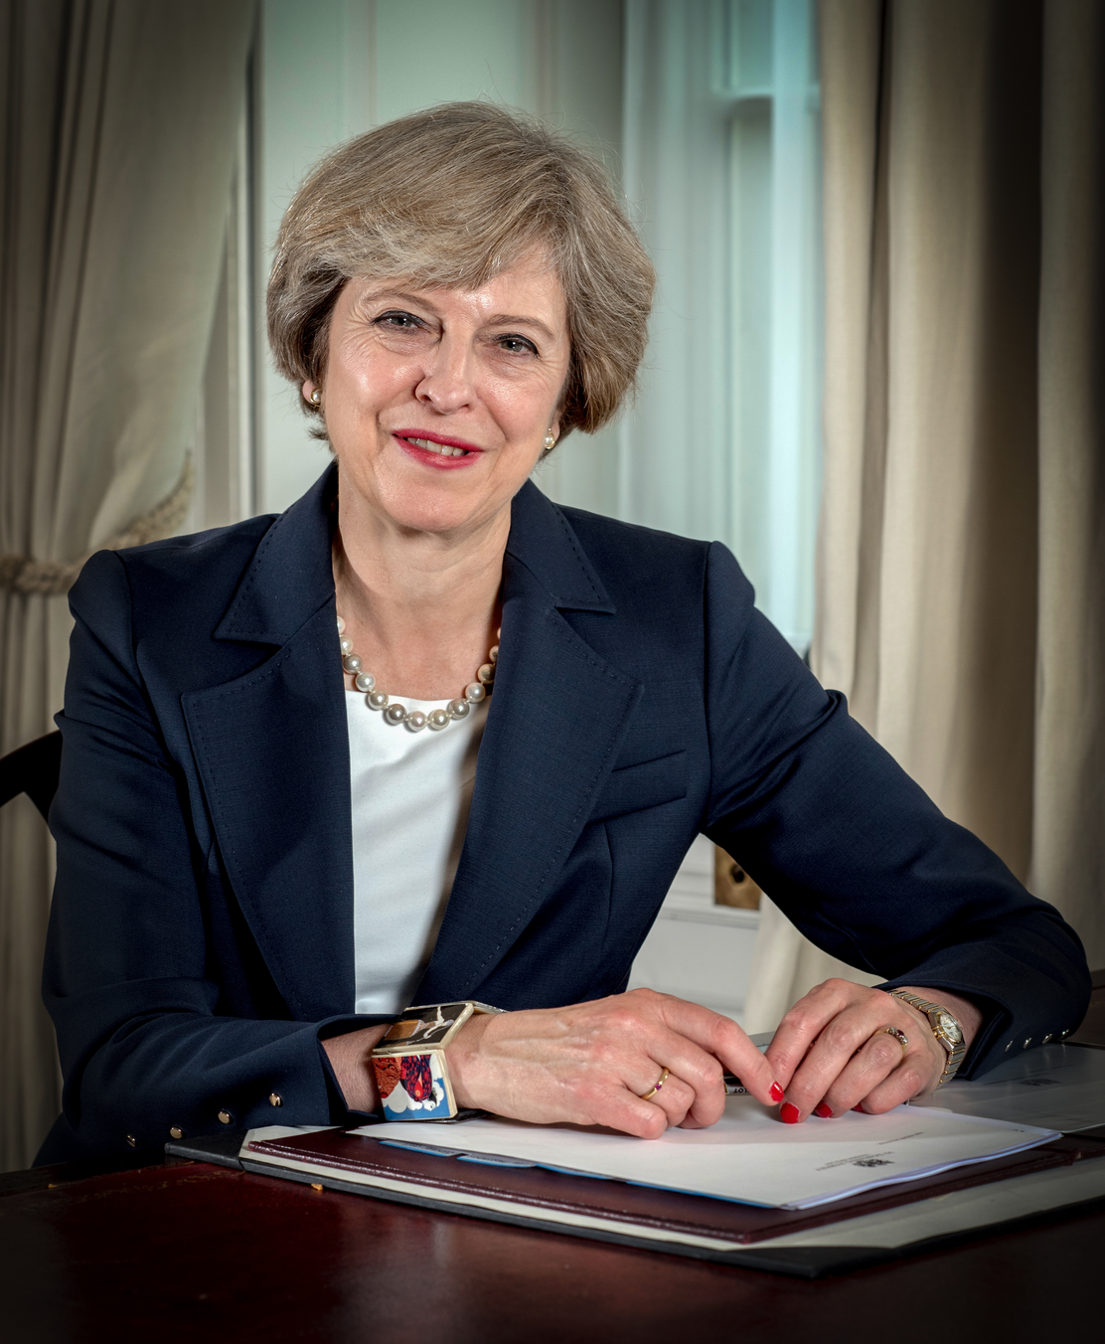
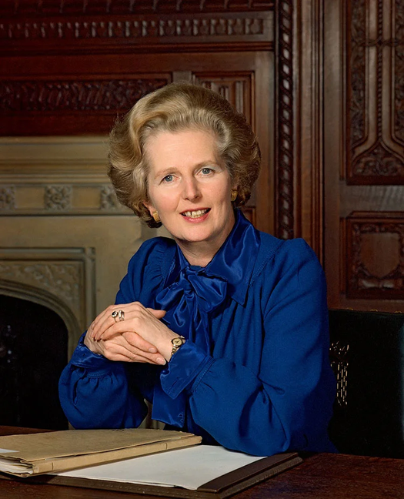
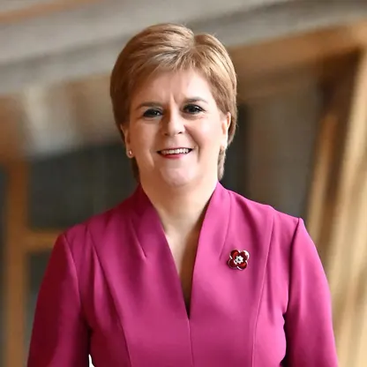
1
WHO WAS THE FIRST FEMALE PRIME MINISTER OF THE UK?
A.
THERESA MAY
B.
MARGARET THATCHER
C.
NICOLA STURGEON
ICEBREAKER 1
| 16

Slide 21

1
ANSWER
B. Margaret Thatcher
Why it matters: She became Prime Minister in 1979, marking a major milestone in UK political history.
B.
MARGARET THATCHER
ICEBREAKER 1
| 17

Slide 22
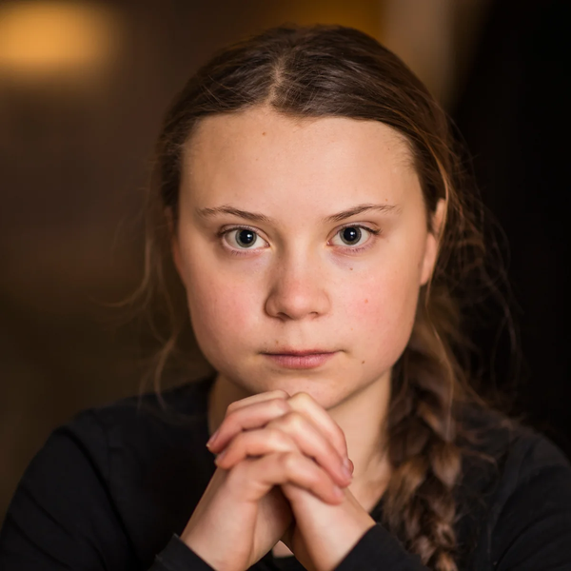
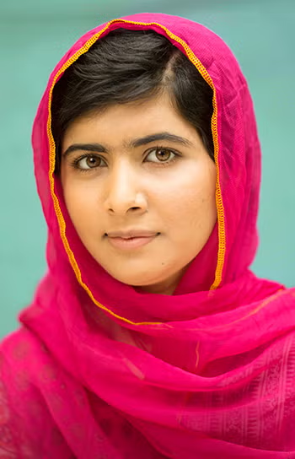
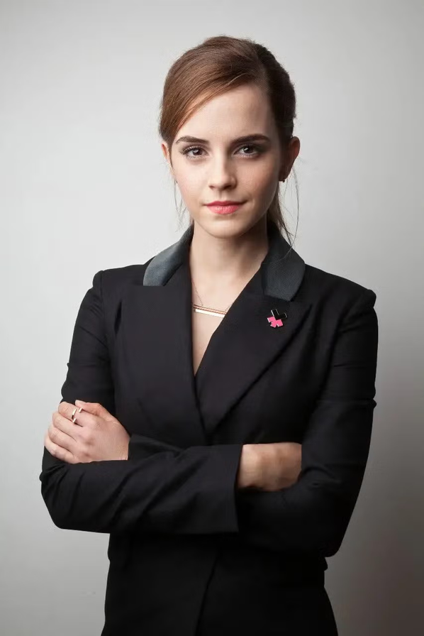
2
WHO BECAME THE YOUNGEST EVER NOBEL PEACE PRIZE WINNER FOR CAMPAIGNING FOR GIRLS’ EDUCATION?
A.
GRETA THUNBERG
B.
MALALA YOUSAFZAI
C.
EMMA WATSON
ICEBREAKER 1
| 18

Slide 23
2
ANSWER
B. Malala Yousafzai
Why it matters: She won the Nobel Peace Prize at 17 and continues to campaign for girls’ access to education worldwide, directly linking to IWD’s focus on equal opportunity.
B.
MALALA YOUSAFZAI
ICEBREAKER 1
| 19

Slide 24
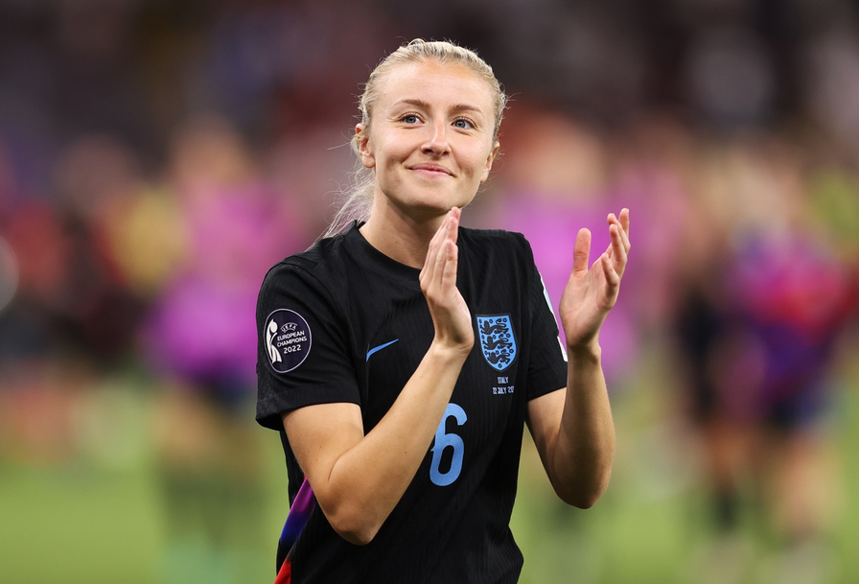
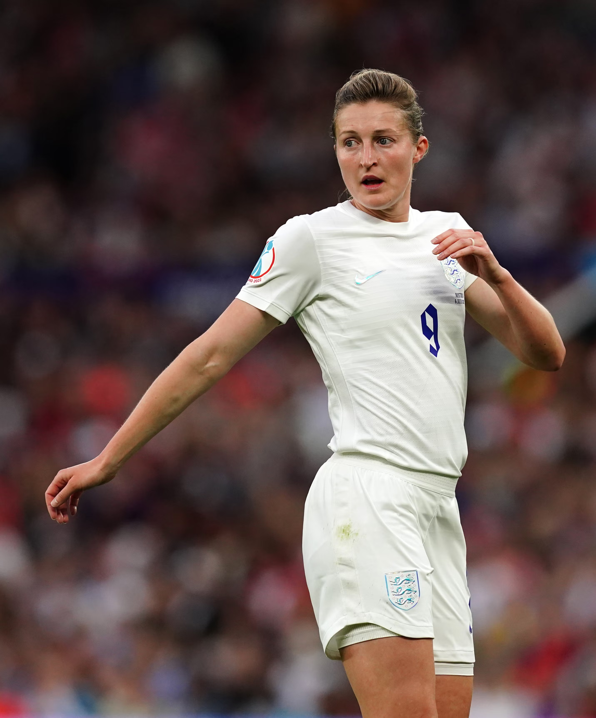

3
WHO SCORED A HAT-TRICK IN THE UEFA WOMEN’S EURO 2022 FINAL FOR ENGLAND?
A.
LEAH WILLIAMSON
B.
ELLEN WHITE
C.
ELLA TOONE
ICEBREAKER 1
| 20

Slide 25
3
ANSWER
C. Ella Toone
Why it matters: The Lionesses’ Euro 2022 win significantly increased visibility and investment in women’s sport in the UK.
C.
ELLA TOONE
ICEBREAKER 1
| 21

Slide 26

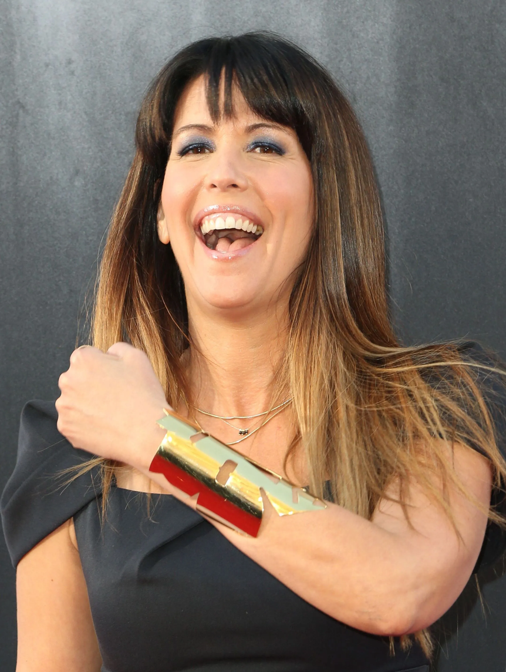
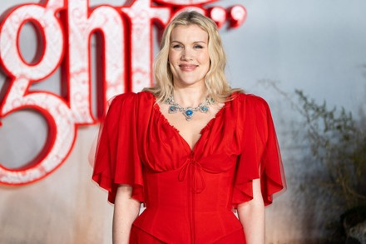
4
WHO DIRECTED THE HIGHEST-GROSSING FILM OF 2023 AND BECAME THE FIRST SOLO FEMALE DIRECTOR TO PASS 1 BILLION AT THE BOX OFFICE?
A.
GRETA GERWIG
B.
PATTY JENKINS
C.
EMERALD FENNELL
ICEBREAKER 1
| 22

Slide 27

4
ANSWER
A. Greta Gerwig
Why it matters: Barbie became a global phenomenon and sparked discussions about gender roles, representation, and empowerment in mainstream media.
A.
GRETA GERWIG
ICEBREAKER 1
| 23

Slide 28
ICEBREAKER OPTION 2
QUIZ
Complete the international women’s day quiz & learn more about the movement.
| 24

Slide 29

1
What date is International Women’s Day held each year?
A
1st March
C
5th March
B
8th March
D
15th March
ICEBREAKER 2
| 25

Slide 30
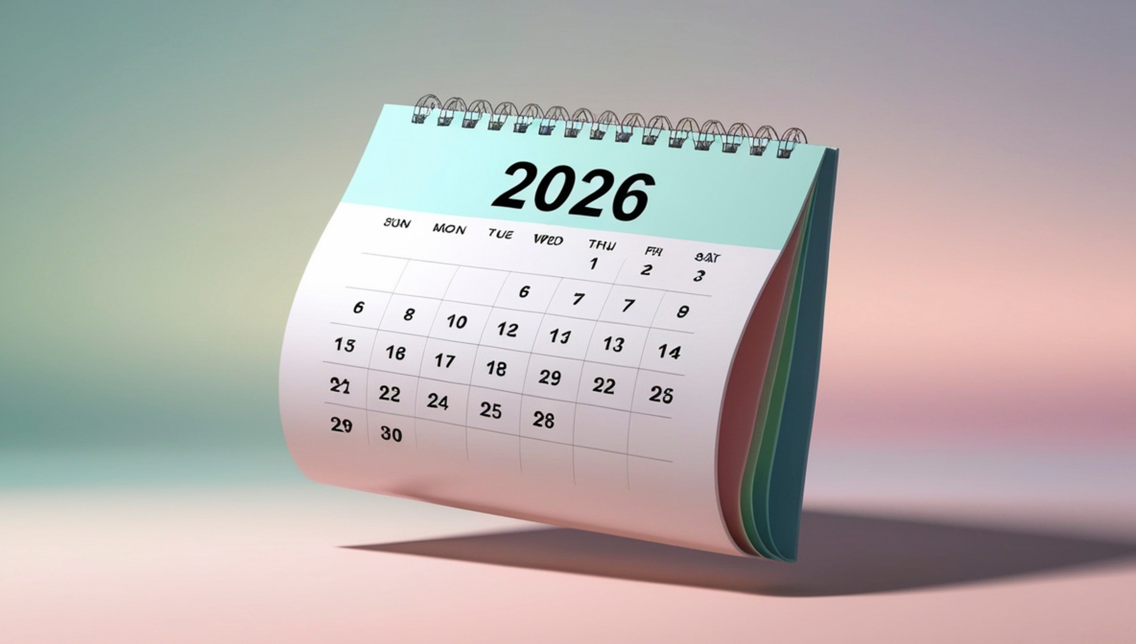
2
In which year was the first International Womens Day held?
A
1899
C
1911
B
1948
D
1975
ICEBREAKER 2
| 26

Slide 31
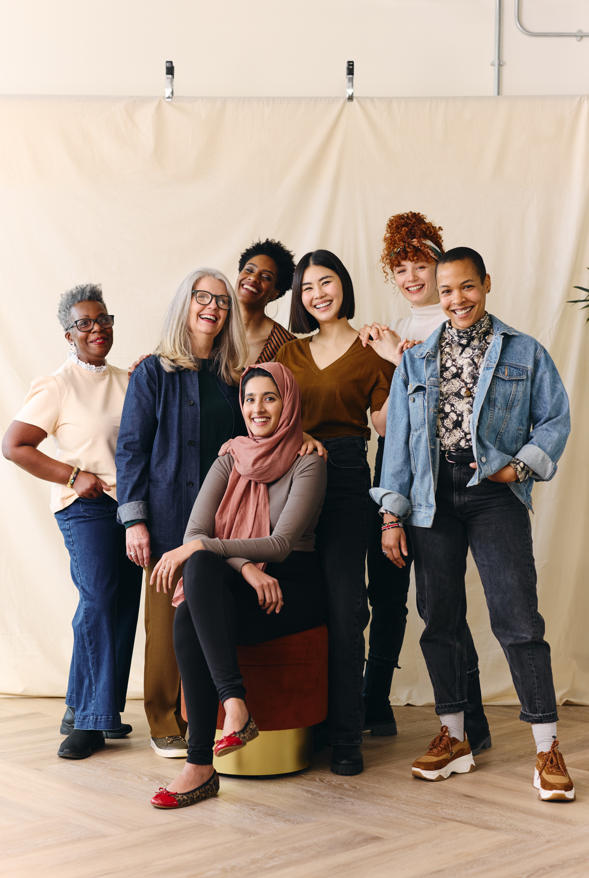
3
Which global organisation officially recognises International Women’s Day?
A
FIFA
C
The World Bank
B
NATO
D
The United Nations
ICEBREAKER 2
| 27

Slide 32
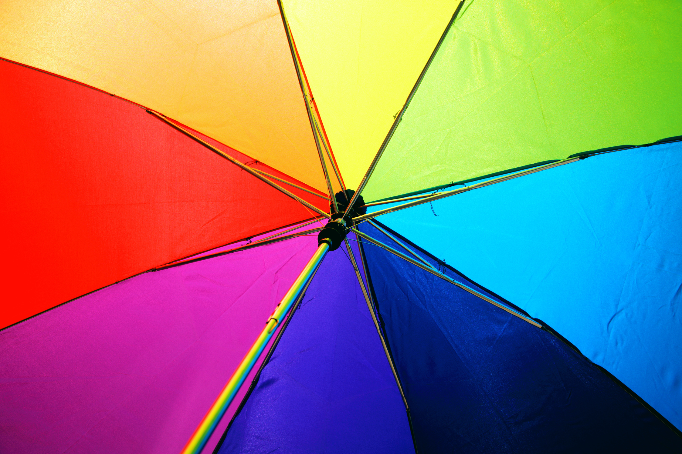
4
What colours are traditionally associated with IWD?
A
C
Purple, White & Green
Purple & Pink
B
Purple, Pink & White
D
Purple & White
ICEBREAKER 2
| 28

Slide 33
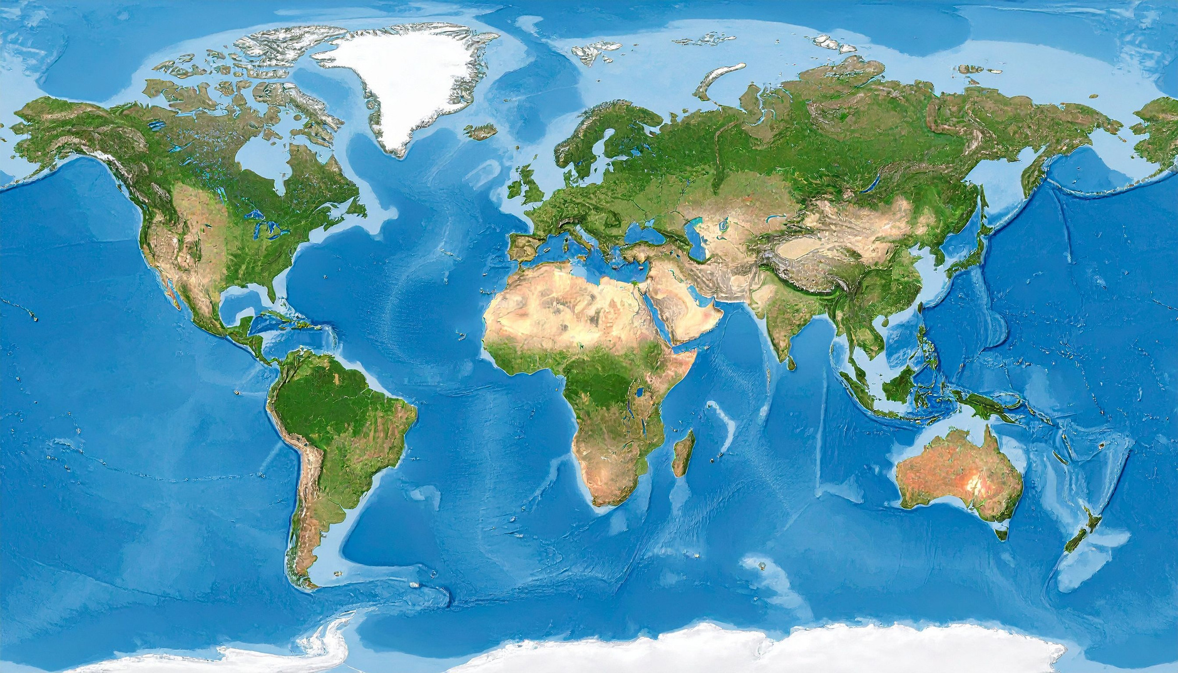
5
In which region do people get the day off work for IWD?
A
North America
C
Western Europe
B
Eastern Europe and Central Asia
D
Oceania
ICEBREAKER 2
| 29

Slide 34

6
Why is there a specific theme for IWD every year?
A
To focus globally on a specific issue
C
To select a host country
B
To award a female leader
D
To choose the official colours
ICEBREAKER 2
| 30

Slide 35
Answers
Q1
Q2
Q3
B
8th March
C
1911
D
The United Nations
Q4
Q5
Q6
C
Purple, White & Green
B
Eastern Europe and Central Asia
A
To focus globally on a specific issue
Purple = Justice & Dignity | Green = Hope | White = Unity
ICEBREAKER 2
| 31

Slide 36
ICEBREAKER OPTION 3
EMOJI FILM DECODE
Can you guess the film that features strong female leads or stories from the emoji’s?
| 32

Slide 37
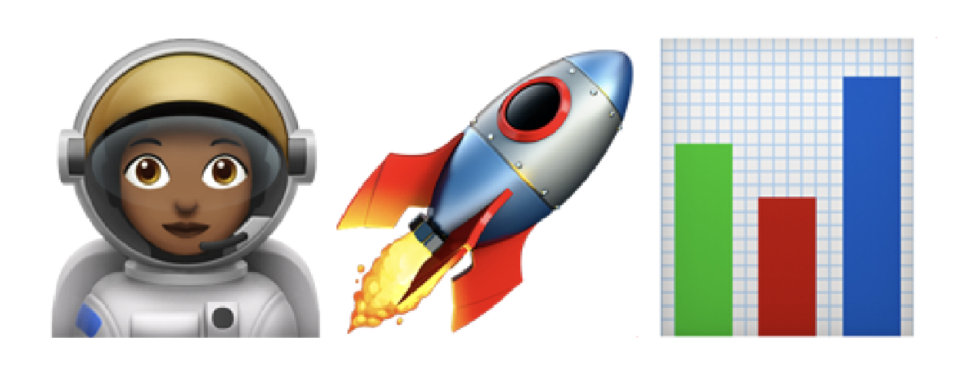
1
Guess the film?
ICEBREAKER 3
| 33

Slide 38

1
Correct Answer
Hidden Figures
  Showed the true story of Black women mathematicians at NASA.
  Helped highlight overlooked contributions of women in STEM.
  Links to IWD aim: Celebrating achievements previously ignored.
ICEBREAKER 3
| 34

Slide 39
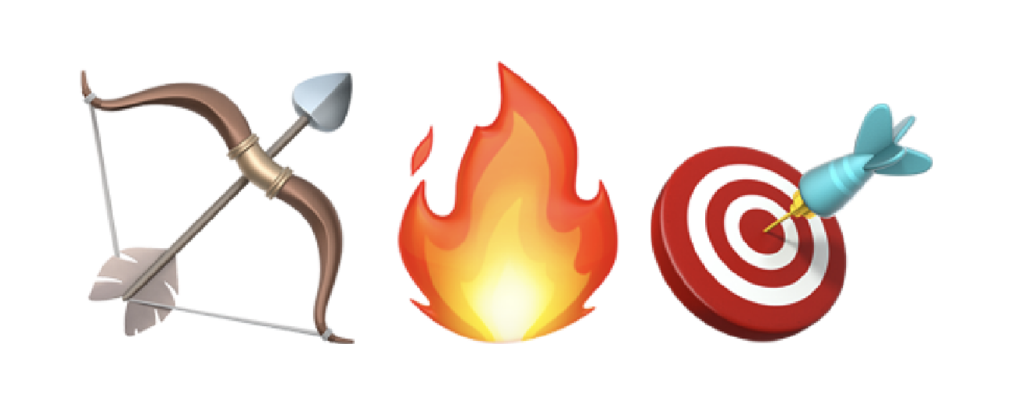
2
Guess the film?
ICEBREAKER 3
| 35

Slide 40

2
Correct Answer
Hunger Games
  Katniss became a symbol of resistance and strength.
  Challenged the “male action hero” stereotype.
  Sparked discussions about female leadership in mainstream cinema.
ICEBREAKER 3
| 36

Slide 41

3
Guess the film?
ICEBREAKER 3
| 37

Slide 42

3
Correct Answer
Legally Blonde
  Shattering stereotypes and proving that femininity and high-level intelligence aren't mutually exclusive.
  Promotes ambition, resilience, and breaking assumptions.
ICEBREAKER 3
| 38

Slide 43

4
Guess the film?
ICEBREAKER 3
| 39

Slide 44
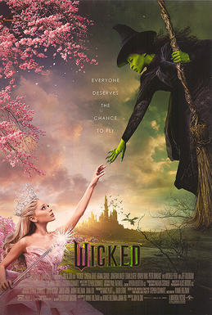
4
Correct Answer
Wicked
  A massive pop-culture moment for this age group. It celebrates an unlikely female friendship and the idea that being "wicked" is often just a label for a woman who stands up for what she believes in.
ICEBREAKER 3
| 40

